Slide 1
REFRIGERATION
Refrigeration:
It is a method of reducing the temperature of a system below that of the surroundings & maintaining it at that lower temperature by continuously extracting the heat from it by the aid of external work.
Refrigerant:
The working fluid in a refrigeration system is called as refrigerant which continuously extracts the heat from the space within the refrigerator or any other system which is to be kept cool at temperatures less than the atmosphere and finally rejects to it to the surroundings.
Department of Mechanical and Manufacturing Engineering

Slide 2
Principle of Refrigeration
Heat flows from a system at higher temperature to another at lower temperature.
The boiling temperature of a fluid depend on its pressure.
Fluids by absorbing the heat, change from liquid phase to vapour phase and subsequently condense to liquid phase by giving off the heat.
Heat can flow from a system at low temperature to a system at higher temperature by the aid of external work as per the Second law of Thermodynamics.
Department of Mechanical and Manufacturing Engineering

Slide 3
Parts of a Refrigeration system
A refrigeration system consists of four main parts namely
1. Device A: Compressor
2. Device B: Condenser
3. Device C: Expansion Valve
4. Device D: Evaporator
Department of Mechanical and Manufacturing Engineering

Slide 4
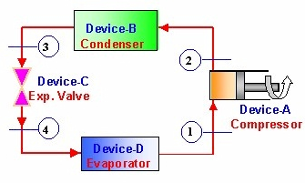
Parts of a Refrigeration system
Department of Mechanical and Manufacturing Engineering

Slide 5
Evaporator:
The evaporator is the heart of the refrigerator where the liquid refrigerant is evaporated by the absorption of heat from the refrigerator cabinet in which the substances which have to be cooled are kept.
The evaporator consists of a metal tubing known as Evaporator Coil which surrounds the freezing and cooling compartments of the refrigerator.
Department of Mechanical and Manufacturing Engineering

Slide 6
Compressor:
It is used to circulate the refrigerant in the refrigeration cycle
It increases the pressure and therefore the temperature of the refrigerant.
It is driven by the electrical motors.
Department of Mechanical and Manufacturing Engineering

Slide 7
Condenser:
It is a device in which the heat from the refrigerant which is at higher temperature is rejected to another medium usually atmospheric air.
In a condenser the refrigerant vapour gives off its latent heat to the cooling medium and condenses into liquid so that it can be expanded in the expansion device.
The heat given off in the condenser includes the heat absorbed in the evaporator as well as the heat developed during compression.
Department of Mechanical and Manufacturing Engineering

Slide 8
Expansion Valve or Throttle valve:
An expansion valve serves as a device to reduce the pressure of the refrigerant coming from the condenser suddenly and hence its temperature before it passes to the, evaporator.
Department of Mechanical and Manufacturing Engineering

Slide 9
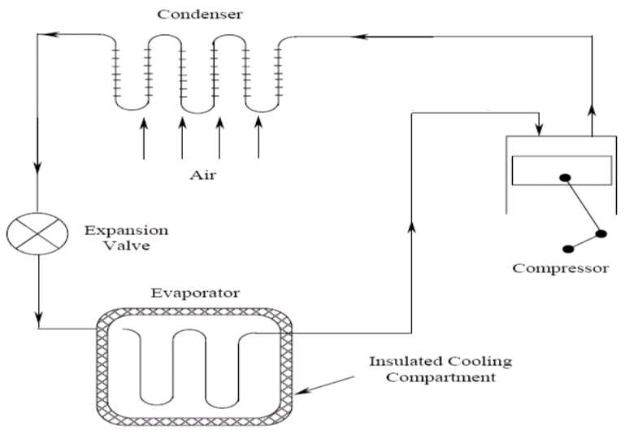
Vapour Compression Refrigeration System
HP & LT
Liquid refrigerant
HP & HT
Vapour refrigerant
LP & LT
Vapour refrigerant
LP &LT
Liquid+ vapour refrigerant
Department of Mechanical and Manufacturing Engineering

Slide 10
Vapour Compression Refrigeration System
In a vapour compression refrigeration system a refrigerant is circulated through the system in which it alternately evaporates and condenses, thus undergoing a change of phase from liquid to vapour and again from vapour to liquid.
Vapour compression system makes use of the mechanical energy supplied to the compressor to run the refrigerator.
Department of Mechanical and Manufacturing Engineering

Slide 11
The Vapour Compression Cycle consists of an evaporator made of coiled tubes installed in the freezing compartment of the refrigerator and is connected to the suction side of the compressor and the exit of the throttle valve.
The delivery side of the compressor is connected to the condenser inlet.
Condenser outlet is connected to the inlet of the throttle valve.
Department of Mechanical and Manufacturing Engineering

Slide 12
In the Evaporator:
Low-pressure low-temperature refrigerant in semi vapor semi liquid state enters the Evaporator coils.
As it flows through the evaporator, it absorbs heat from the contents of the freezing compartment, gains its Latent heat and gets converted into vapour phase.
Department of Mechanical and Manufacturing Engineering

Slide 13
In the Compressor:
Low-pressure low-temperature refrigerant vapour from the evaporator is drawn by the compressor.
In the compressor, it is compressed to higher pressures so that the saturation temperature of the refrigerant corresponding to the increased pressure is higher than that of the cooling medium in the condenser, so that high-pressure high-temperature refrigerant vapour can reject heat in the condenser.
Department of Mechanical and Manufacturing Engineering

Slide 14
In the Condenser:
High-pressure high-temperature refrigerant vapour from the compressor enters the condenser.
In the condenser, refrigerant vapour gives off its Latent heat to the atmospheric air and gets condensed into liquid.
Department of Mechanical and Manufacturing Engineering

Slide 15
In the Expansion Valve:
High-pressure condensed liquid refrigerant approximately at room temperature flows through the expansion valve (throttle valve) where it expands to low pressure and low temperature.
Department of Mechanical and Manufacturing Engineering

Slide 16
State & Condition of the Refrigerant
INLET
OUTLET
Vapour
LP, LT
Vapour
HP, HT
Compressor
Vapour
HP, HT
Liquid
HP, LT
Condenser
Liquid
HP, LT
Liquid+ Vapour
LP, LT
Throttle valve
Liquid+ Vapour
LP, LT
Vapour
LP, LT
Evaporator
Department of Mechanical and Manufacturing Engineering

Slide 17
Unit of Refrigeration
In a refrigeration system, the rate at which the heat is absorbed in a cycle from the interior space to be cooled is called Refrigerating Effect.
The capacity of a refrigeration system is expressed in Tons of refrigeration which is the unit of refrigeration.
A ton of refrigeration is defined as the quantity of heat absorbed to convert one ton of water at 0⁰C to one ton of ice at the same temperature in 24 hours.
Department of Mechanical and Manufacturing Engineering

Slide 18
Unit of Refrigeration – contd.
Here it should be noted that one American ton (2000 pounds) is taken as the standard in the refrigeration practice.
In S.I. System,
1 Ton of Refrigeration = 210 kJ/min = 3.5 kW
Department of Mechanical and Manufacturing Engineering

Slide 19
Coefficient of Performance of a Refrigerator
The performance of a refrigeration system is expressed by a factor known as Coefficient of Performance (COP).
The COP of a refrigeration system is defined as the ratio of amount of heat absorbed or extracted in a system to the amount of work supplied.
Amount of heat absorbed
COP = ---------------------------------
Amount of work supplied
Therefore, the performance indicator of a refrigerator COP can be improved by increasing the amount of heat absorbed from a system and by minimizing the amount of work supplied.
Department of Mechanical and Manufacturing Engineering

Slide 20
Desirable Properties of Refrigerant
In order to produce a good refrigeration effect, an ideal refrigerant must possess certain desirable properties which are categorized as below:
(A) Thermodynamic Properties
(B) Physical Properties
(C) Safe Working Properties
(D) Other Properties
Department of Mechanical and Manufacturing Engineering

Slide 21
Properties of a Good Refrigerant
Thermodynamic Properties
Physical Properties
Safe working properties
Other Properties
Boiling point
Freezing point
Evaporator & Condenser Pressure
Latent heat of evaporation
Viscosity
Specific Volume
Toxicity
Flammability
Corrosiveness
Chemical Stability
COP
Odour
Action with Lubricating Oil
Thermal Conductivity
Specific Heat
Department of Mechanical and Manufacturing Engineering

Slide 22
Properties of an Ideal Refrigerant
1. Thermodynamic properties:
Boiling point:
An ideal refrigerant should have low boiling temperature to give better refrigeration effect.
Freezing point:
An ideal refrigerant should have low freezing point, because the refrigerant should not freeze at lower temperature.
c. Evaporator & condenser pressure:
To detect the leakage of refrigerant, both the evaporator & condenser pressures should be above the atmospheric pressure.
Department of Mechanical and Manufacturing Engineering

Slide 23
d. Specific Heat:
A good refrigerant must have high specific heat when it is vapourised and low specific heat when it is in liquid state. The high specific heat of the refrigerant helps in decreasing the super-heating of the vapour. The low specific heat of the refrigerant helps in sub-cooling of the liquid and easy drop in temperature after expansion. Both these desirable properties will increase the refrigerating effect.
Latent heat of evaporation:
This must be very high so that a minimum amount of refrigerant will give the desired result. In other words, it increases the refrigeration effect.
.

Slide 24
d. Physical properties:
Viscosity:
The viscosity of a refrigerant in both the liquid and vapour states must be very low as it improves the heat transfer and reduces the pumping effort required.
b. Specific volume:
It is the volume per unit mass. It must be very low, as it will reduce the size of the compressor
c. Thermal conductivity:
Refrigerant should have high thermal conductivity for high heat transfer
Department of Mechanical and Manufacturing Engineering

Slide 25
Safe Working Properties:
Toxicity:
A good refrigerant should be non toxic, because any leakage of the refrigerant results in poisoning the atmosphere in the refrigerator.
b. Flammability: A good refrigerant should have very low flammability and should be non explosive.
c. Corrosiveness:
A good refrigerant should be non corrosive, to prevent the corrosion of metal parts of the refrigeration system.
d. Chemical Stability: An ideal refrigerant must not decompose under operating conditions.
Department of Mechanical and Manufacturing Engineering

Slide 26
4. Other Properties:
Coefficient of Performance (COP): The COP of a refrigerant must be high so that the energy spent in refrigeration will be less.
Odour: A good refrigerant must be odourless otherwise some food stuff such as meat, butter, etc. will lose their taste.
Action with Lubricating Oil: A good refrigerant must not react with the lubricating oil used in lubricating the parts of the compressor.
It should be easily available and economical
Department of Mechanical and Manufacturing Engineering

